Slide 1


shima pilehvari
19/02/2024

Slide 2

Outline
Executive Summary
Introduction
Methodology
Results (inside of each section)
Conclusion

Slide 3
Executive Summary
1)Summary of methodologies
Data was gathered through the SpaceX REST API and by employing web scraping techniques.
The data was then cleaned to establish a variable indicating the outcome of each launch as a success or failure.
Various data visualization methods were used to examine factors such as payload, launch site, flight number, and trends over time.
Using SQL, data analysis was conducted to calculate metrics like total payload, the payload range for successful missions, and the count of successful versus failed launches.
The research further explored the success rates of different launch sites and their locations relative to key geographical features.
Visualization techniques highlighted the most successful launch sites and the range of payloads for successful missions.
Predictive models, including logistic regression, support vector machine (SVM), decision trees, and K-nearest neighbors (KNN), were developed to forecast the outcomes of landing
2) Summary of all results
Findings from Exploratory Data Analysis:
The rate of launch success has seen an improvement over time
Among various launch sites, KSC LC-39A has emerged with the highest rate of successful landings.
Orbits such as ES-L1, GEO, HEO, and SSO have achieved a 100% success rate.
Executive Summary of Insights and Predictive Analysis:
Visualization and analysis reveal that most launch sites are positioned near the equator and are proximate to coastal areas.
In predictive analysis, all models demonstrated comparable performance on the test data, with the decision(DT) tree model marginally outperforming others

Slide 4
Introduction
Project background and context:
SpaceX, a pioneering force in aerospace, is committed to making space exploration accessible to all. Its notable achievements include dispatching spacecraft to the International Space Station, deploying a satellite network for global internet coverage, and conducting crewed space missions. The affordability of SpaceX launches, priced at approximately $62 million per launch, is attributed to its innovative reuse of Falcon 9's first stage – a feat not matched by competitors, whose launches can exceed $165 million due to the lack of reuse capability. The ability to predict the successful landing of the first stage is crucial for estimating launch costs. Utilizing publicly available data and machine learning techniques, we aim to forecast whether SpaceX or its rivals will be able to recover the first stage for reuse.
Investigation Areas:
- Examining the impact of factors such as payload mass, launch site, flight frequency, and orbit types on the success of first-stage landings.
- Trends in landing success rates over the years.
- Identifying the most effective prediction model for forecasting successful landings, a key aspect of binary classification.

Slide 5

Section 1

Slide 6
Methodology
Executive Summary
To analyze the factors influencing successful rocket landings, the study employed the following condensed approach:
Data was collected via SpaceX REST API and web scraping to compile detailed datasets.
Data wrangling prepared the data by filtering, handling missing values, and applying one-hot encoding.
Exploratory Data Analysis (EDA) was used for data exploration, with SQL for queries and various visualization tools for insights.
Folium and Plotly Dash visualized data through maps and interactive web apps, respectively, to highlight key patterns.
Predictive models forecasted landing outcomes using classification algorithms, with fine-tuning and evaluation to identify the most effective model and parameters.

Slide 7
Data Collection
Procedures for data collection :
Retrieve rocket launch data from the SpaceX API.
Utilize .json() for decoding and .Json normalize() to transform into a data frame.
Fetch details on launches via SpaceX API through specialized functions.
Construct a dictionary based on the gathered data.
Generate a data frame from this dictionary.
Narrow down the data frame to include solely Falcon 9 launches.
Fill in missing Payload Mass values with the average calculated using .mean().
Save the compiled data into a CSV file

Slide 8
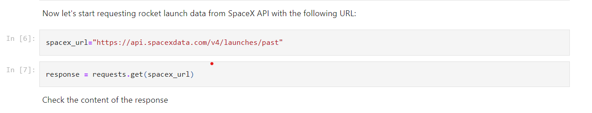
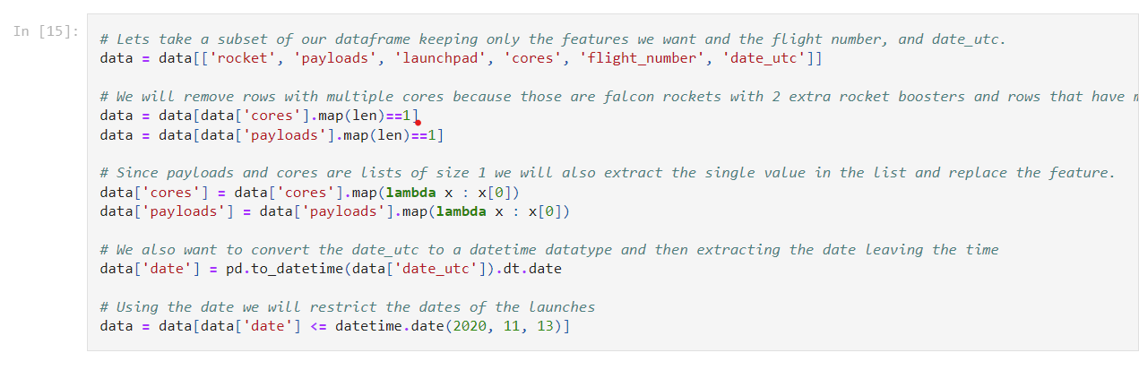
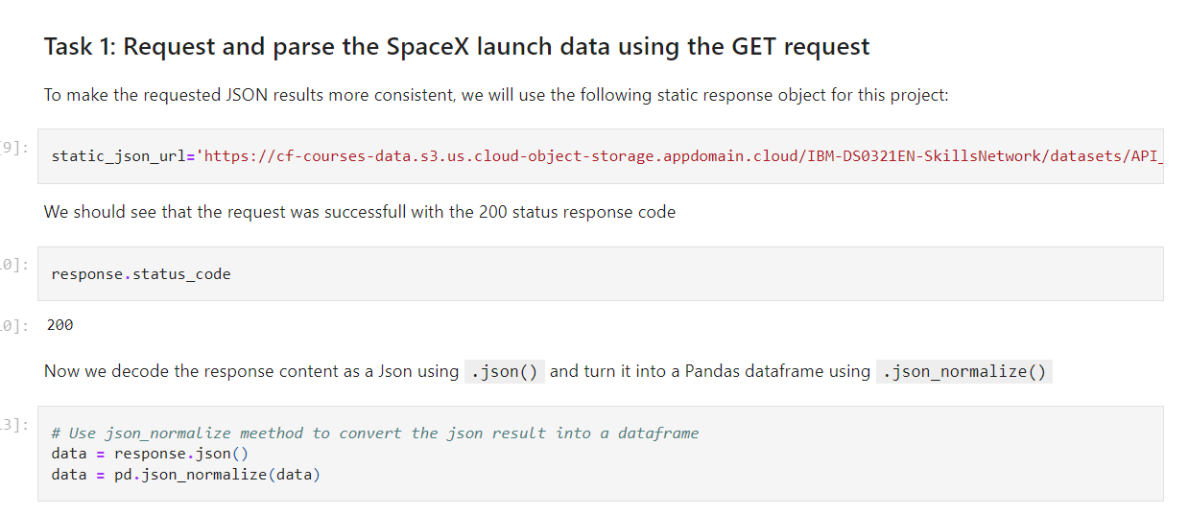
Data Collection – SpaceX API
Process Overview:
Initiate a GET request to retrieve data on rocket launches via the API.
Employ the 'json_normalize' function to transform the 'json' output into a DataFrame.
Undertake data cleaning activities and address any missing values accordingly.

Slide 9
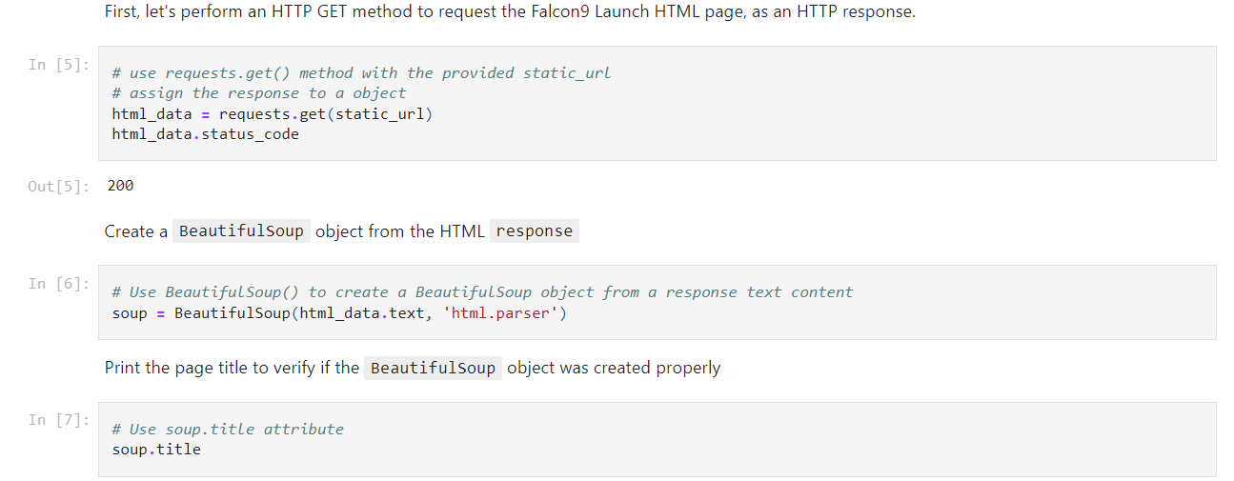
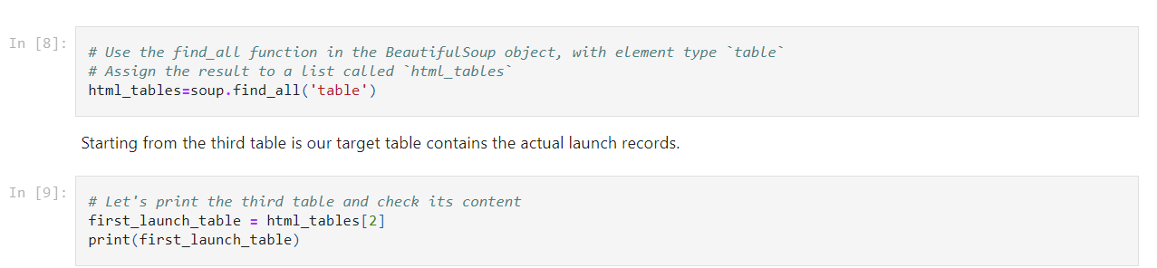
Data Collection - Scraping
Web Scraping for Data Acquisition:
A common method to gather data on Falcon 9 launches involves web scraping from associated Wikipedia pages. To accomplish this, we will utilize the Beautiful Soup package in Python, focusing on extracting vital information from HTML tables that hold Falcon 9 launch records.
Retrieve the Falcon 9 launch information from the specified URL.
Generate a Beautiful Soup object using the HTML content received.
Identify and extract the names of all columns/variables from the HTML headers.

Slide 10
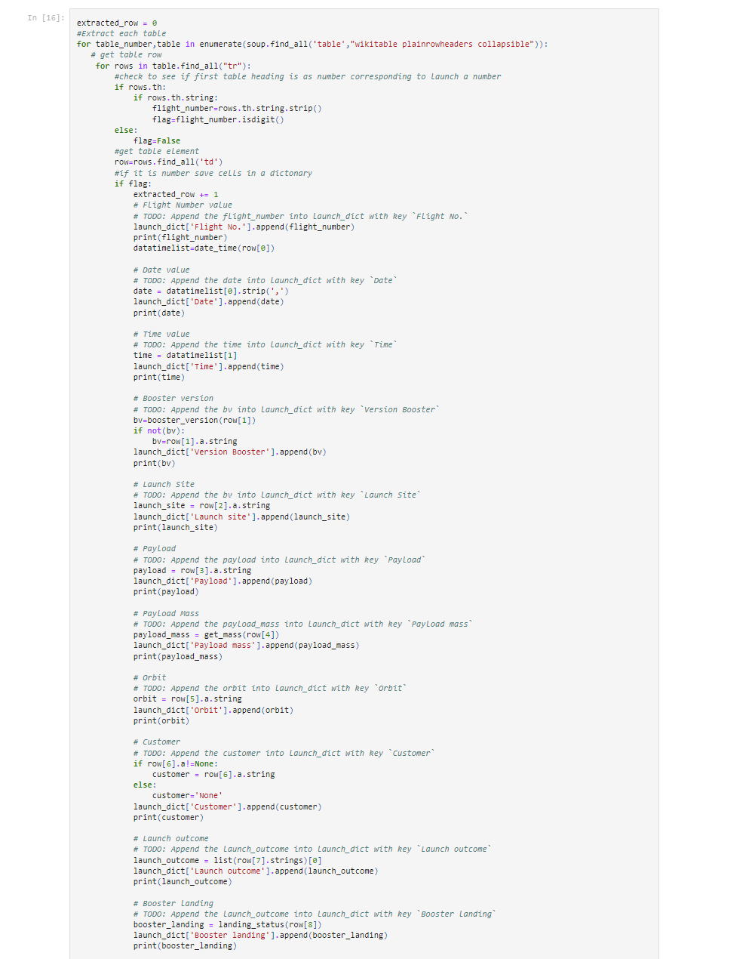
Data Collection - Scraping

Slide 11
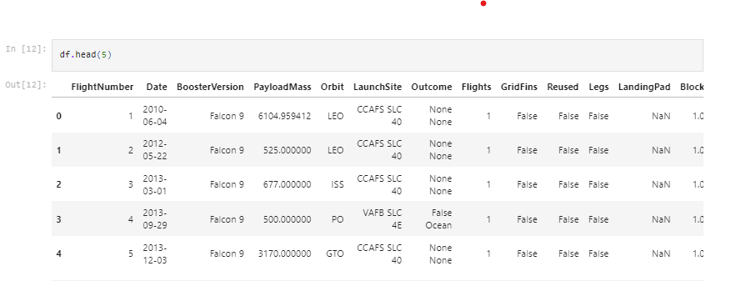
Data Wrangling
Data Preparation and Analysis:
Data preparation, or "Data Wrangling," involves the process of refining and consolidating complex and disorganized data sets to facilitate accessibility and Exploratory Data Analysis (EDA). Our initial step will involve determining the frequency of launches at each site, followed by assessing the number and frequency of mission outcomes across various orbit types. Subsequently, we will generate a "landing outcome" label derived from the outcome column to simplify subsequent analyses, visualizations, and machine learning processes. The final step will include exporting the organized data into a CSV file.
The exploratory phase aims to uncover patterns within the data and establish appropriate labels for training supervised learning models. Within our dataset, multiple instances indicate unsuccessful booster landings. In these scenarios, we will categorize the outcomes into Training Labels, where '1' denotes a successful booster landing and '0' signifies an unsuccessful attempt, as indicated by the 'Class' feature.

Slide 12
Model Construction: - Import the dataset into NumPy and Pandas. - Process and split the data into training and test sets. - Select the ML model type. - Configure GridSearchCV with parameters and algorithms, then apply it to the dataset.
Predictive Analysis (Classification)
Model Enhancement:
- Implement Feature Engineering and Algorithm Tuning, utilizing grid
search to identify optimal hyperparameters
Model Evaluation:
- Assess each model's accuracy.
- Retrieve optimized hyperparameters for all algorithms.
- Generate the confusion matrix.

Slide 13

Section 2

Slide 14
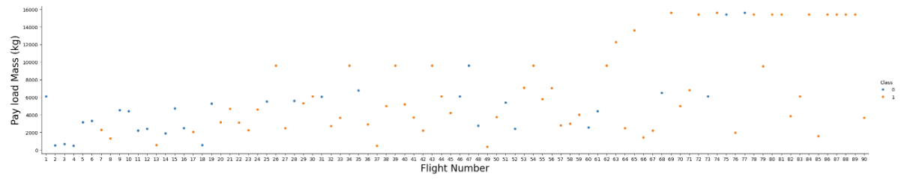
EDA with Data Visualization
We'll dive into Exploratory Data Analysis (EDA) by visualizing data to uncover patterns and relationships. Key focuses include comparisons between Flight Number, Payload Mass, Launch Site, Orbit Type, and annual launch success trends. We aim to highlight geographical details of launch sites, especially their locations relative to coastlines, railways, and highways, using visual maps to represent launch outcomes.
Our primary tools for initial insights will be scatter plots, examining:
Payload Mass vs. Flight Number
Flight Number vs. Launch Site
Orbit Type correlations with Flight Number and Payload Mass
This streamlined approach helps us quickly identify significant data trends and relationships.
As observed in the scatter plot, flight numbers increase, successful first-stage landings become more likely. However, heavier payloads reduce this likelihood.

Slide 15
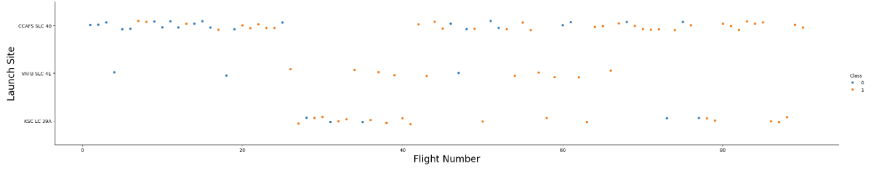
EDA with Data Visualization
The analysis reveals that the launch site CCAFS LC-40 achieves a 60% success rate, whereas KSC LC-39A and VAFB SLC 4E both exhibit a higher success rate of 77%.

Slide 16
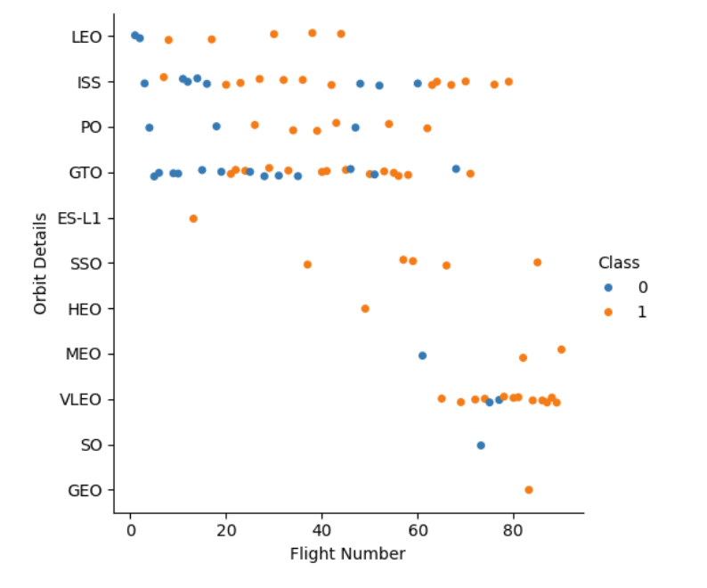
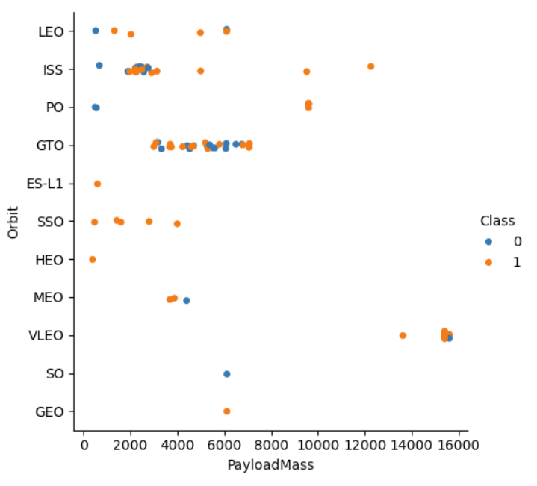
EDA with Data Visualization
we can observe that Success in LEO orbits increases with more flights, while in GTO orbits, flight number doesn't impact success.
For Polar, LEO, and ISS orbits, heavier payloads correlate with higher successful landing rates. In contrast, for GTO orbits, success rates are mixed, with both successful and unsuccessful missions present, regardless of payload weight.

Slide 17
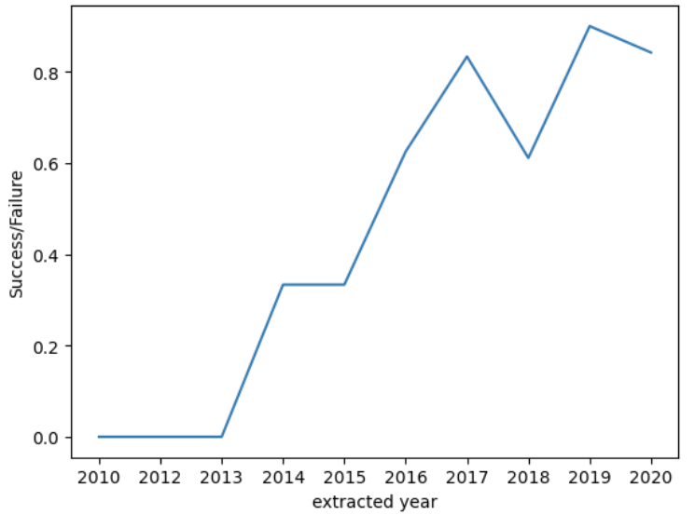
EDA with Data Visualization
Launch Success over Time
The success rate see an increase between 2013-2017 and 2018-2019, while it declined from 2017-2018 and from 2019-2020. However, looking at the trend since 2013, there has been an overall improvement in the success rate.

Slide 18
EDA with SQL
Using SQL, we performed several analyses on our dataset, as follows:
- Listed launch site names.
- Showed 5 records for launch sites starting with 'CCA'.
- Calculated the total payload mass for NASA's CRS program launches.
- Determined the average payload mass for the F9 v1.1 booster version.
- Identified the date of the first successful ground pad landing.
- Listed boosters that successfully landed on drone ships with payloads between 4000 and 6000.
- Counted the successful and failed missions.
- Identified booster versions carrying the maximum payload.
- Listed failed drone ship landings in 2015, including booster versions and launch sites.
- Ranked landing outcomes by count, from 2010-06-04 to 2017-03-20, in descending order.

Slide 19
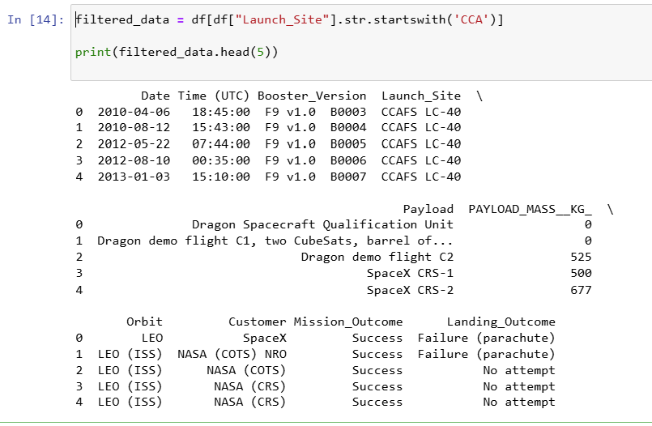
Launch site names begin with `CCA
All launch site names
CCAFS LC-40
VAFB SLC-4E
KSC LC-39A
CCAFS SLC-40
CCAFS LC-40
CCAFS SLC-40

Slide 20
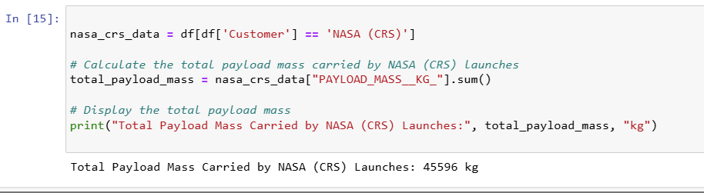
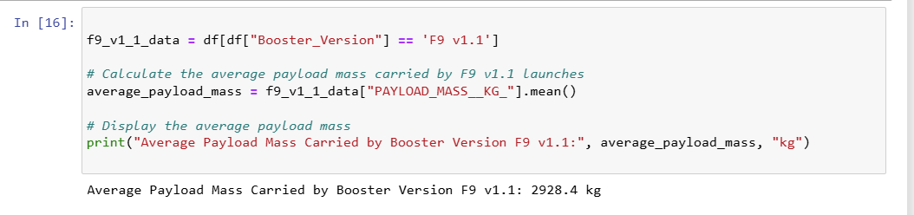
total payload carried by booster from NASA
Average payload mass by F9 v1.1

Slide 21
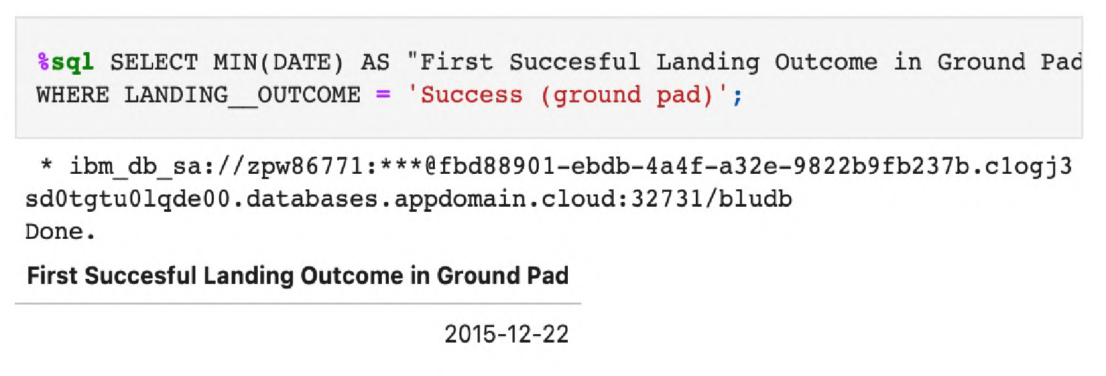
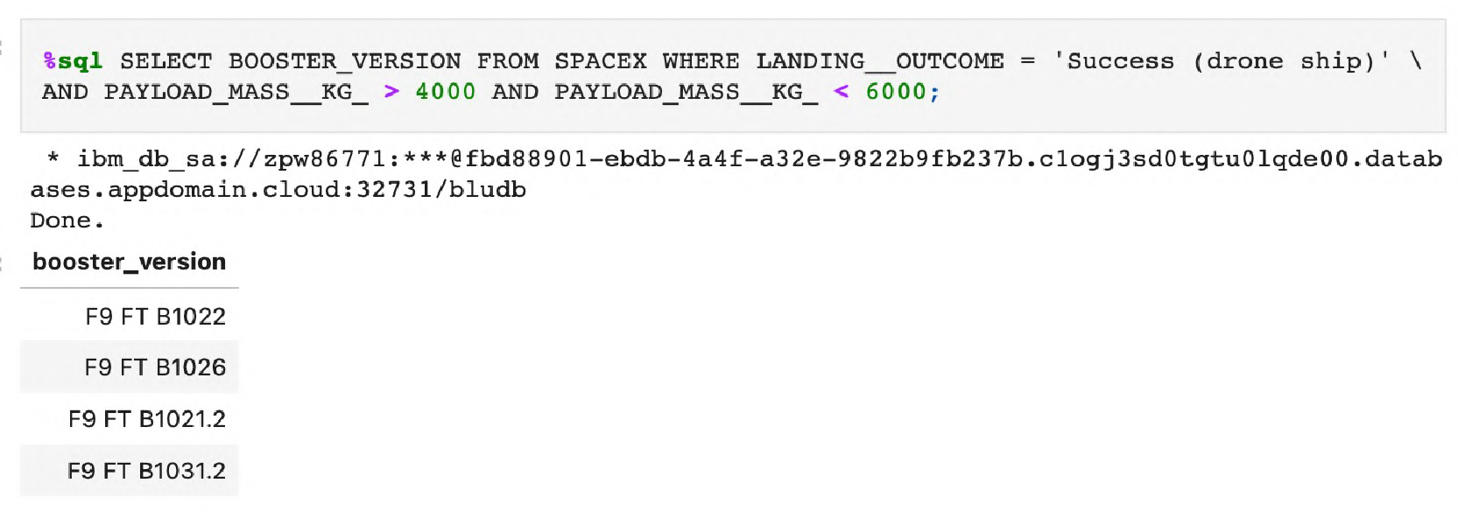
First successful ground landing date:
Successful drone ship landing with payload between 4000 and 6000:
F9 FT B1022
F9 FT B1026
F9 FT B1021.2
F9 FT B1031.2

Slide 22
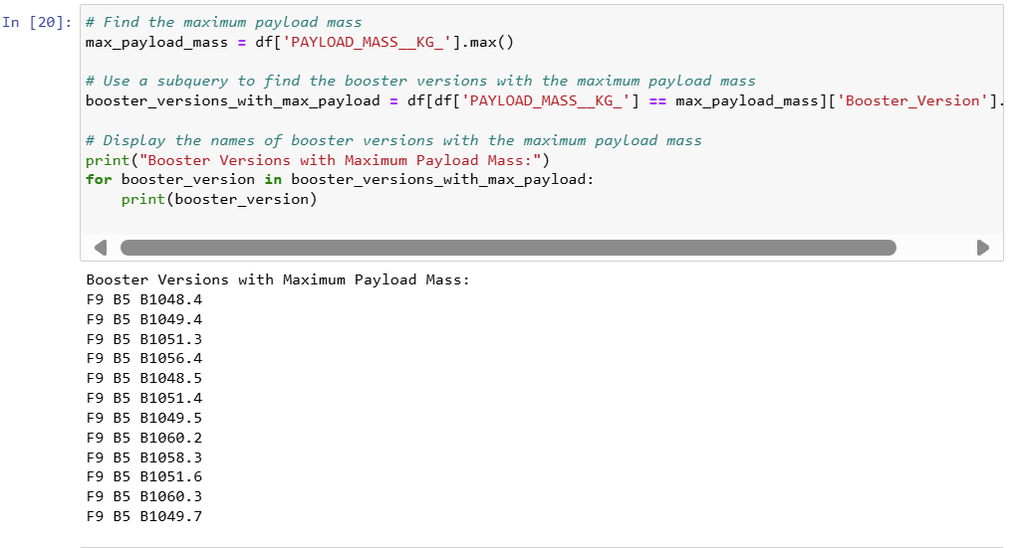
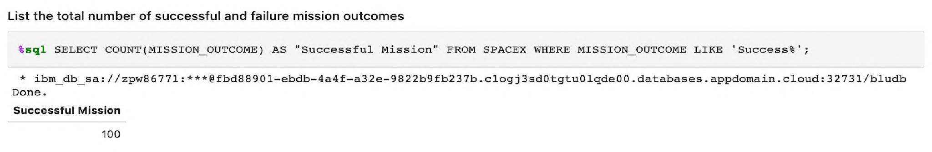
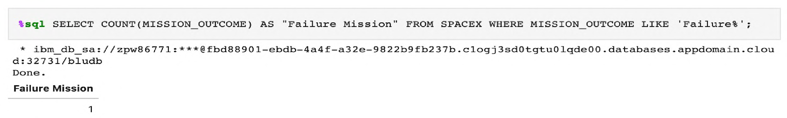
Total number of successful and failure mission outcomes and Boosters carried maximum payload

Slide 23
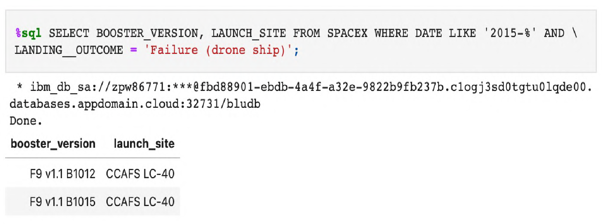
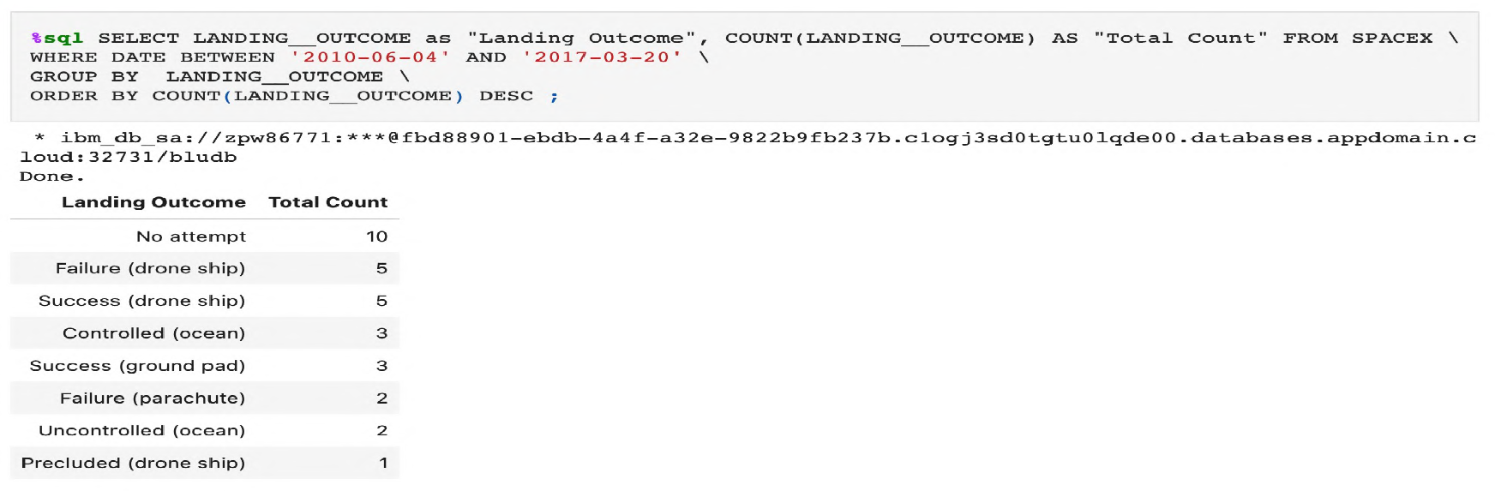
2015 launch records
Rank success count between 2010-06-04 and 2017-03-20
We used the GROUP BY clause to aggregate the landing outcomes and the ORDER BY clause to sort them in descending order, allowing us to identify patterns within the specified time frame.

Slide 24

Section 3

Slide 25
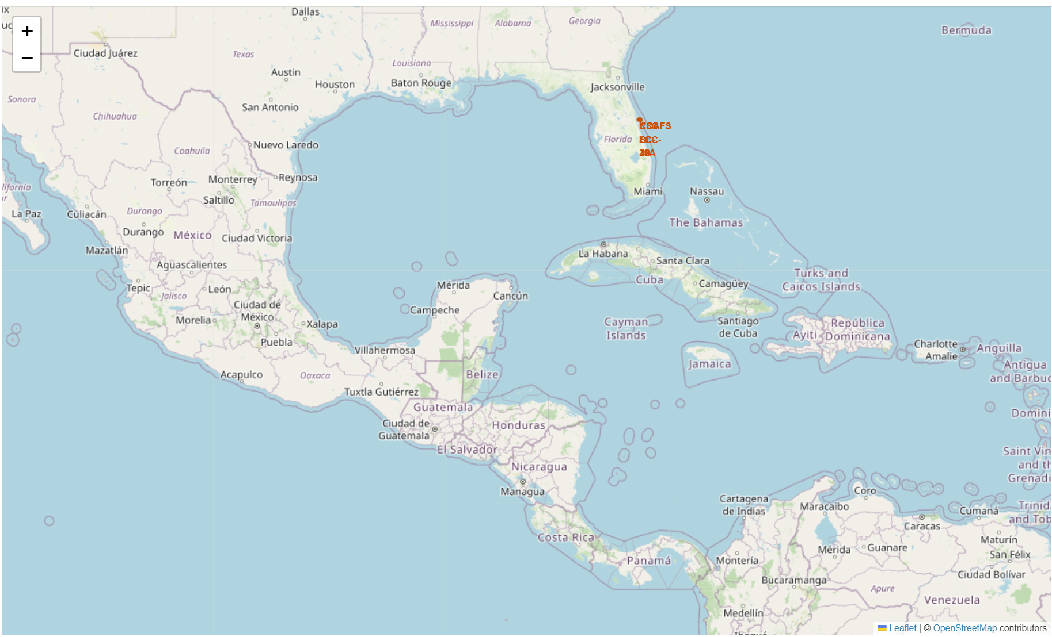
Build an Interactive Map with Folium
1. Extracted coordinates for each launch site and marked them with labeled circles.
2. Classified launch outcomes as 0 (failure) and 1 (success), displaying them with red and green markers in a clustered layout.
Additionally, distances between launch sites and key landmarks were calculated using Haversine's formula to explore:
Distance to railways, highways, and coastlines.
Proximity to nearby cities.

Slide 26
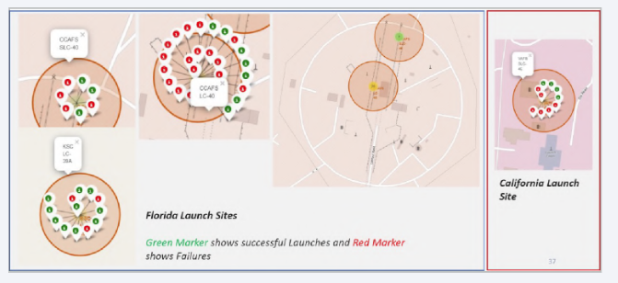
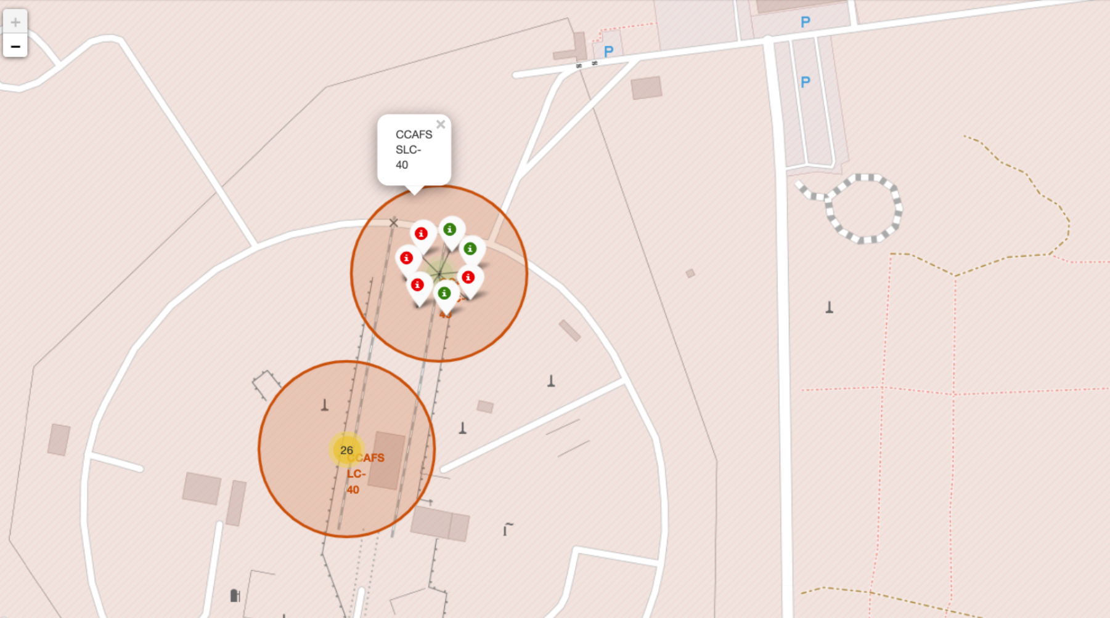
Launch Outcomes
At Each Launch Site
Green markers for successful launches
Red markers for unsuccessful launches
Launch site CCAFS SLC-40 has a 3/7 success rate (42.9%)

Slide 27
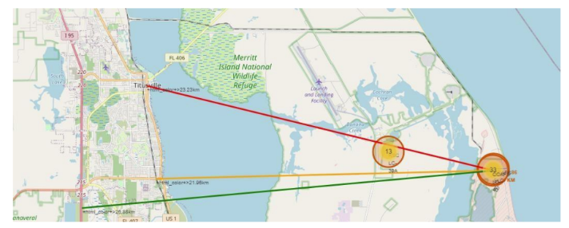
Distance to Proximities
CCAFS SLC-40
• .86 km from nearest coastline
21.96 km from nearest railway
23.23 km from nearest city
26.88 km from nearest highway

Slide 28

Section 4

Slide 29
Build a Dashboard with Plotly Dash
A dynamic dashboard was created utilizing Plotly Dash, which enables users to adjust the data to meet their needs.
Within this dashboard:
The total number of launches from specific sites was displayed using pie charts.
The relationship between the outcomes of the launches and the mass of the payload (in kilograms) across different booster versions was shown using scatter plots.

Slide 30
Build a Dashboard with Plotly Dash
Indeed, we can cover the following points:
- The launch site with the highest number of successful launches.
- The launch site with the greatest success rate for launches.
- The payload range(s) with the highest success rate for launches.
- The payload range(s) with the lowest success rate for launches.
- The Falcon 9 Booster version with the highest launch success rate.of successful launches.

Slide 31
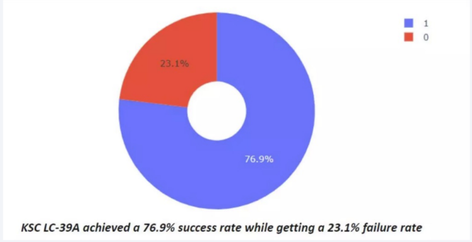
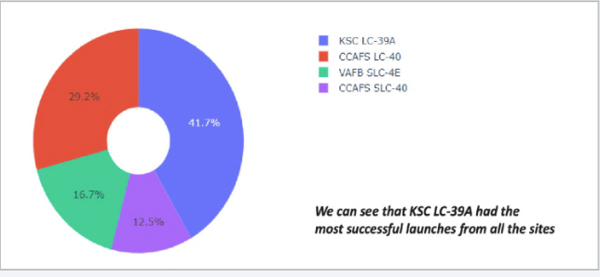
The success percentage by each sites

Slide 32
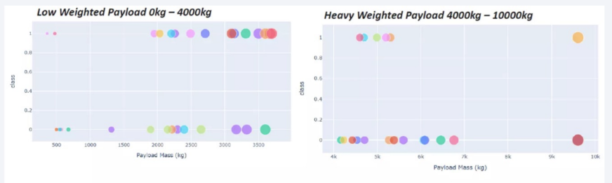
Payload vs launch outcome
We observe that success rates are higher for lighter payloads compared to heavier ones.

Slide 33
Results
The results will be organized into three main segments:
1. Findings from Exploratory Data Analysis (EDA):
- Observations and insights from the initial data exploration.
- Identification of trends, patterns, and notable relationships within the data.
2. Interactive Analytics Demonstration (with Screenshots):
- Visual examples of interactive visualizations and analytics capabilities.
- Illustration of the analytics dashboard's interactive and dynamic features.
3. Outcomes of Predictive Analysis:
- Findings from the predictive modeling process.
- Evaluation of model performance including accuracy, precision, recall, and other relevant metrics.
These sections comprehensively cover the initial analysis, the demonstration of interactive analytics, and the final predictions and evaluations from the predictive analysis phase.

Slide 34

Section 5

Slide 35
Prediction process:
Conduct Exploratory Data Analysis (EDA):
Add a class column to the Data Frame
Normalize or standardize the data
Divide the data into training and test sets to prepare it for prediction
Identify optimal hyperparameters for SVM, Classification Trees, and Logistic Regression using the test dataset

Slide 36
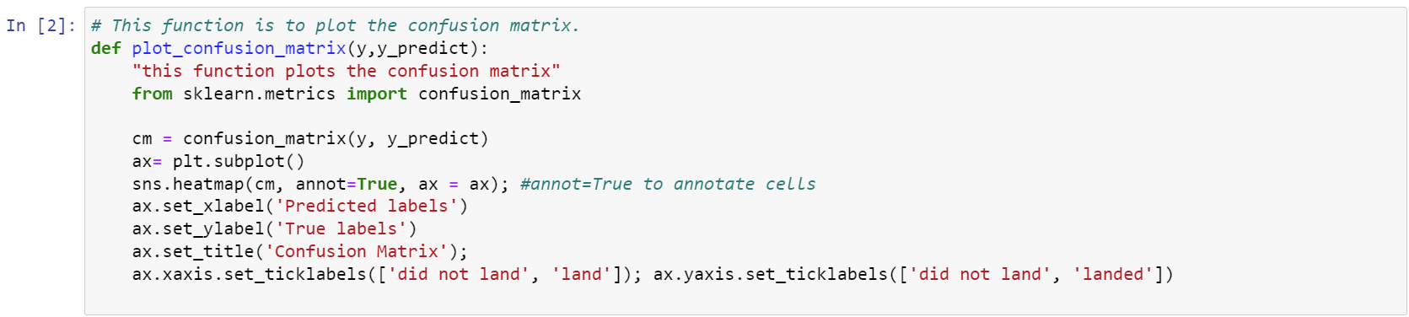
Confusion Matrix
With this function below, the confusion matrix was defined:

Slide 37
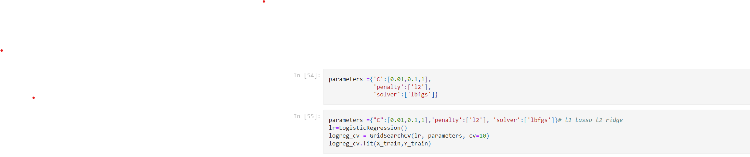
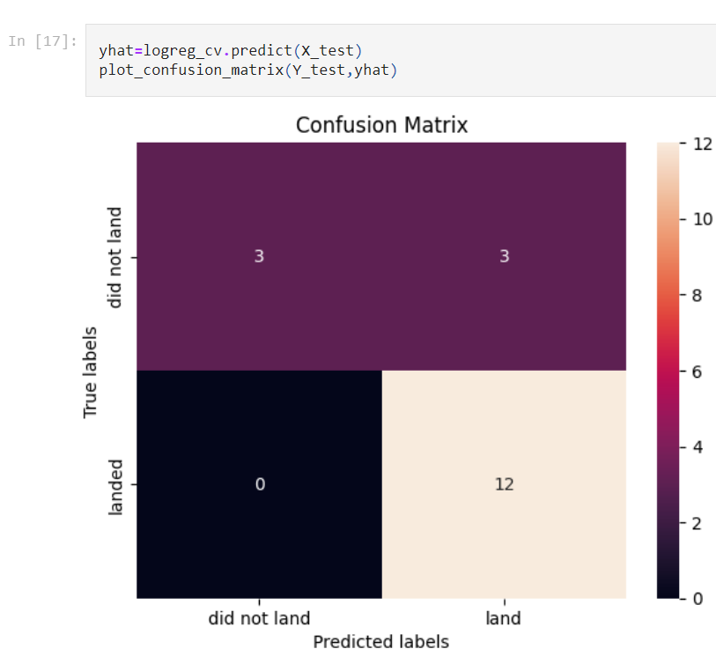
Predicting with Logistic regression:
True positive in testing set is 12 and 3 is false positive.

Slide 38
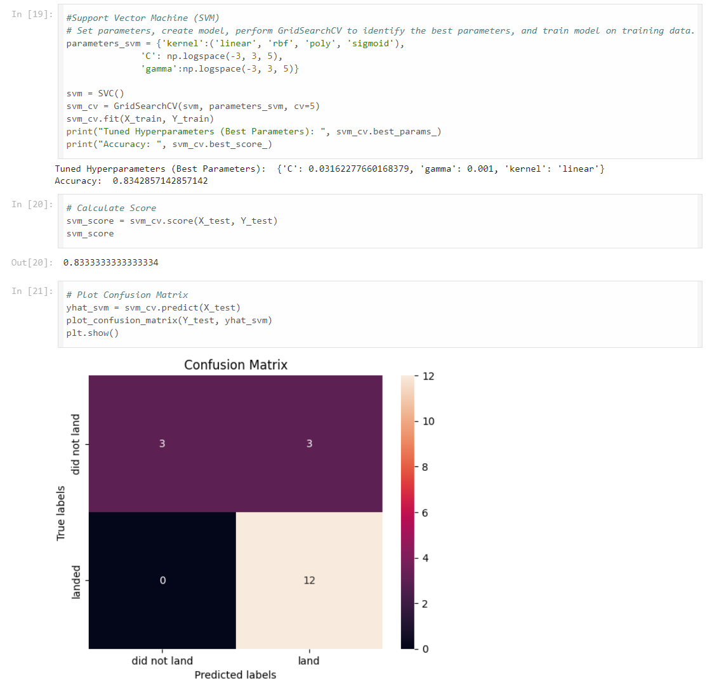
Predicting with Support Vector Machin:
True positive in testing set is 12, meaning the first stage has the successful landing, and 3 is false positive. Accuracy is %83

Slide 39
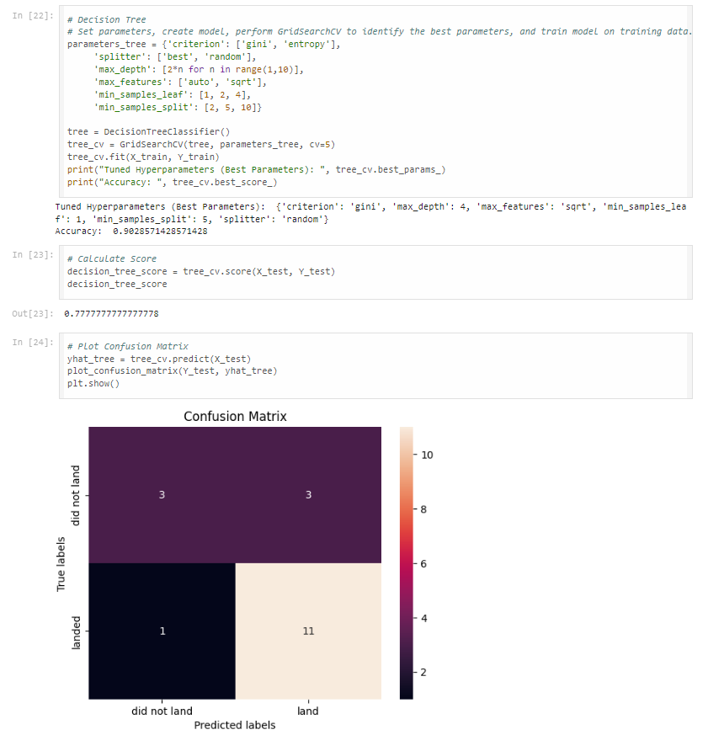
Predicting with Decision Tree:
True positive in testing set in DT model is 11, meaning the first stage has the successful landing, and 3 is false positive.

Slide 40
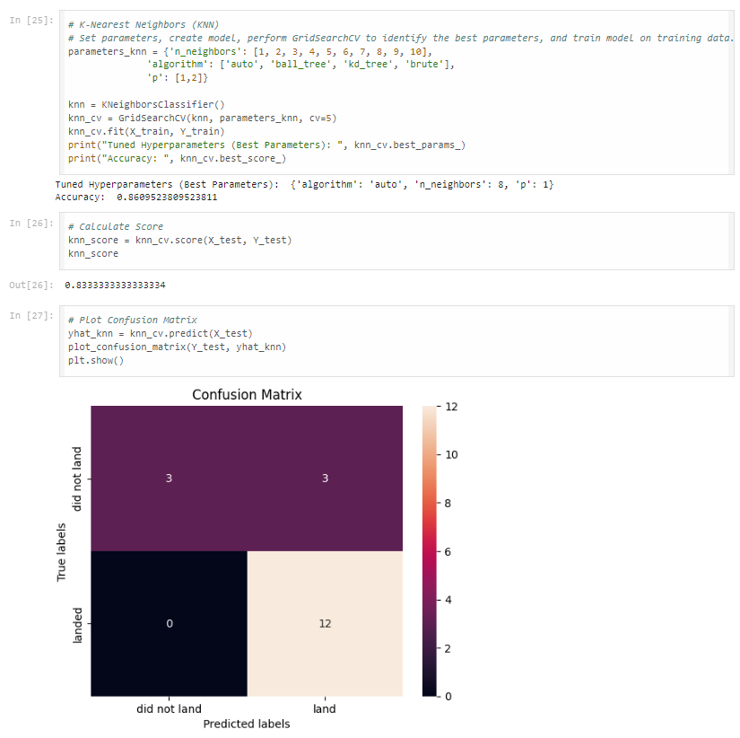
Predicting with KNN:
True positive in testing set in KNN model is 12, meaning the first stage has the successful landing, and 3 is false positive.

Slide 41
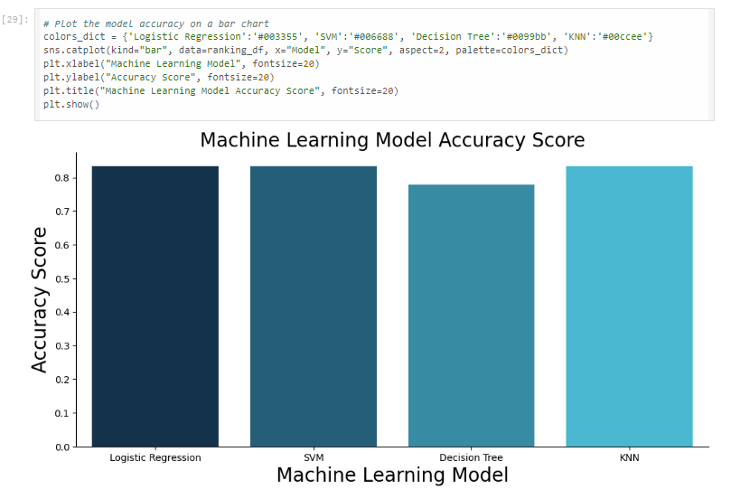
Classification Accuracy

Slide 42
Conclusions
1. SVM, KNN, Logistic Regression, and the decision tree model demonstrated high predictive accuracy, with the decision tree slightly outperforming the others.
2. Launch sites are strategically located near the equator and coastlines to leverage the Earth's rotational velocity, providing a natural boost that minimizes the need for additional fuel and boosters.
3. SpaceX's success rate has increased over the years, indicating an improvement in launch operations.
4. KSC LC 39A has the highest success rates among all launch sites, achieving a 100% success rate for payloads under 5,500 kg.
5. Orbits GEO, HEO, SSO, and ES L1 all recorded a 100% success rate, showcasing the effectiveness of SpaceX's orbital insertion strategies.
6. A noticeable correlation exists between payload mass and success rate, with heavier payloads generally seeing higher success rates, reflecting the maturing capabilities of SpaceX's launch technology.

Slide 43
Conclusions
Application of coding to track and enhance classification accuracy effectively,
can be helpful in evaluation of model performance
The importance of a deeper evaluation beyond simple accuracy measures, thereby improving the presentation's depth and insightfulness.

Slide 44
Innovative Insights
Dataset Expansion: Expanding the dataset could enhance the predictive analytics outcomes, providing insights into whether the observations can be applied to a broader dataset.
Feature Examination/PCA: Conducting further analysis of features or applying principal component analysis could be key in boosting the accuracy of the predictions.
XGBoost Implementation: This study did not incorporate the XGBoost model, known for its effectiveness.

Slide 45


